Slide 1
PEDIATRIC TELE DERMATOLOGY
PIP104 University Project-II
Review-1
Batch Number:
Roll Number | Student Name
20211CSE0823 | MD Haseebuddin
20211CSE0808 | Shaik Ahmed
20211CSE0559 | Mohammed Noaman Ahmed
Under the Supervision of,
Ms. Akkamahadevi
Professor / Associate Professor / Assistant Professor
School of Computer Science & Engineering
Presidency University

Slide 2
Introduction
The diagnosis of neonatal and pediatric skin conditions presents unique challenges, as the patients are highly sensitive and often unable to articulate their symptoms. Skin issues in infants and young children, such as eczema, rashes, birthmarks, or infections, typically exhibit distinct visual characteristics that can be assessed remotely. Given the availability of smartphones and internet access, telemedicine has become a promising solution in this domain.
Remote dermatological consultations, particularly for pediatric and neonatal cases, leverage image-based assessments. These allow healthcare providers to diagnose and recommend treatment plans without the need for in-person visits. This is particularly valuable in regions with limited access to specialized care or during situations where face-to-face consultations may not be feasible. By enabling parents or caregivers to capture images of the child’s skin condition and send them to physicians, healthcare services can be provided quickly and efficiently.
An application that facilitates the remote exchange of medical images, diagnosis tagging, and response management offers significant advantages for both physicians and patients. Furthermore, incorporating the ability to store images for research purposes could contribute to advances in pediatric dermatology by providing valuable data for future studies. In this context, the focus is not on automating diagnosis but on streamlining the communication process between patients and healthcare providers for more efficient and effective care.

Slide 3
Literature Review
(Ahn and Hwang, 2020) :
Enhances access to care, especially in remote areas, but faces challenges with regulations and technology.
(Baker & Zook, 2019):
mHealth apps improve engagement and enable real-time consultations, though privacy concerns exist.
(Bhatia & Manchanda, 2021):
Increases care access but faces issues with image quality and technology disparities.
(Chen & Zhang, 2022):
Deep learning models offer diagnostic accuracy comparable to dermatologists but need further refinement.
(Chiu & Lim, 2019):
mHealth apps can revolutionize dermatology but face regulatory and quality issues.

Slide 4
Proposed Method
Mobile App (React Native):
Image Capture: Users upload or take photos of skin conditions.
Data Submission: App sends image and patient data to the backend via REST API.
Receive Diagnosis: Users receive diagnosis and feedback from physicians.
Backend (Node.js + Express):
REST API: Handles image uploads, stores metadata, and returns diagnosis.
Business Logic: Processes requests and interacts with the database and cloud storage.
Security: Ensures secure communication (JWT, HTTPS).
MySQL Database:
Stores patient information, image metadata, and physician diagnosis tags.
Facilitates data retrieval for research purposes.
Azure Blob Storage:
Securely stores uploaded images.
Provides scalable cloud storage with access control.

Slide 5
Objectives
1. Develop an Image-Based Diagnosis Platform
2. Enable Physician-Tagged Diagnosis
3. Automate Image Storage for Research
4. Provide Secure Communication for Feedback
5. Enhance Usability for Caregivers
6. Ensure Regulatory Compliance and Data Privacy

Slide 6
Methodology
Requirements Gathering
2. System Design
Architecture Design
Database Design
User Interface Design
3. App Development
Frontend Development
Backend Development
This structured methodology ensures the system is developed to meet the requirements of caregivers and physicians while maintaining high security, usability, and scalability.

Slide 7
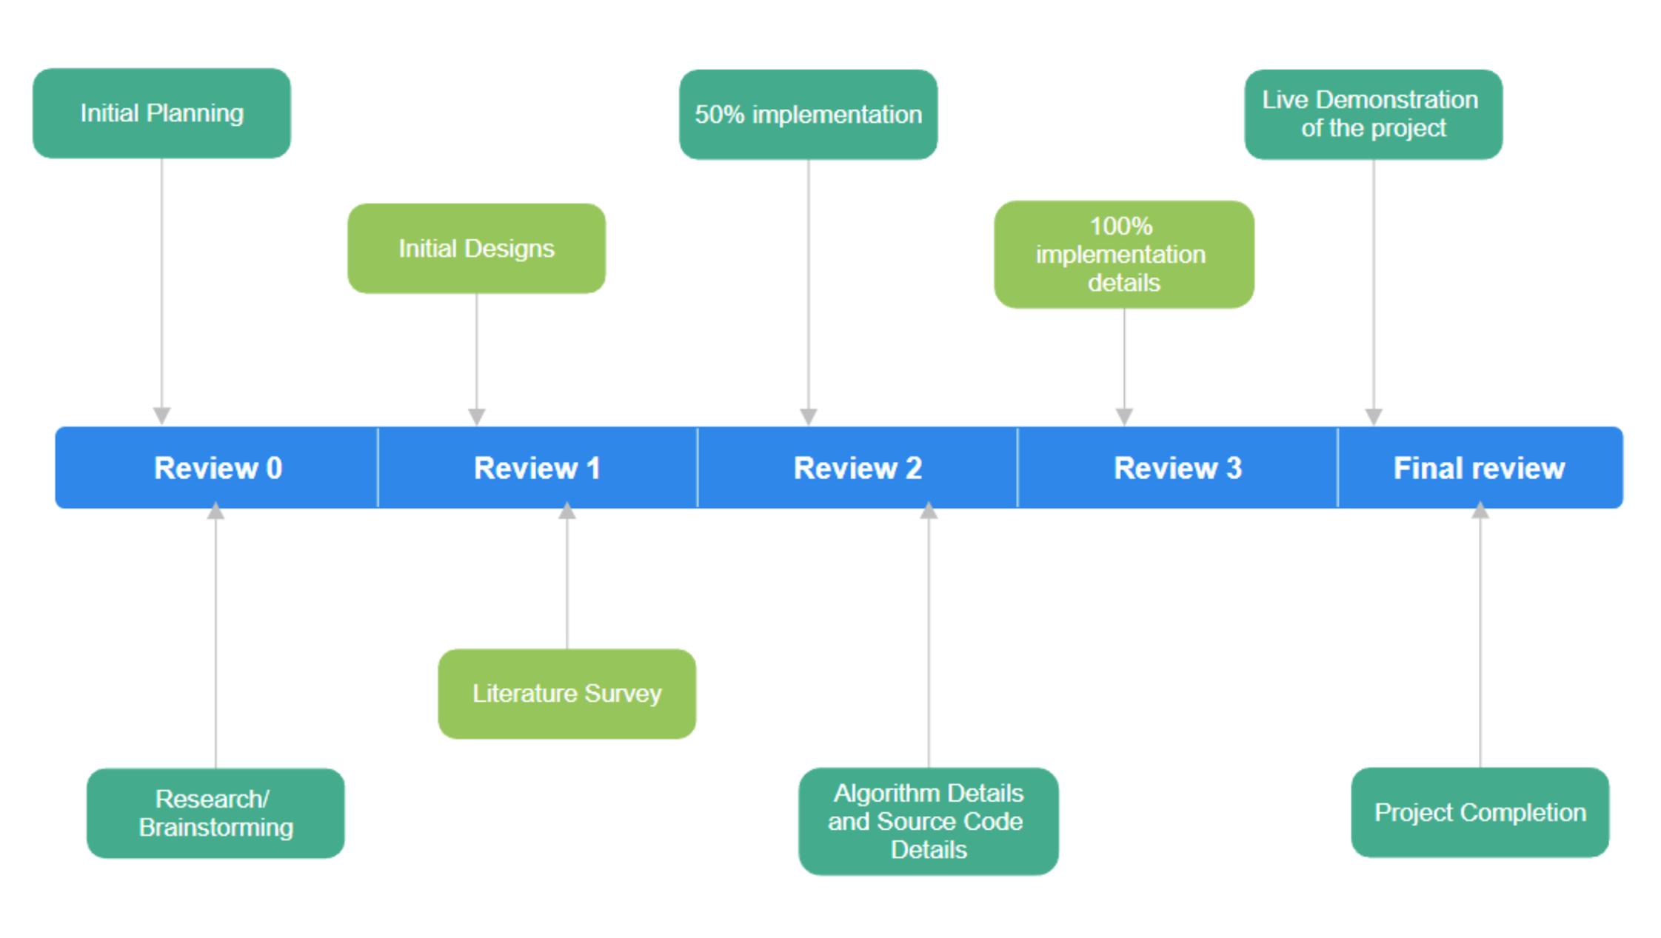
Timeline of Project

Slide 8
Expected Outcomes
Remote Diagnosis:
Efficient diagnosis and feedback via the app, without face-to-face interaction.
2. Secure Storage:
Images stored securely in Azure, with metadata in MySQL for research use.
3. Scalable and Accessible:
Scalable cloud-based system, accessible for patients in remote areas.
4. Support for Research:
Repository of images and diagnoses available for dermatology research.
5. Compliance:
Meets data privacy standards (e.g., HIPAA/GDPR).

Slide 9
Conclusion
The Remote Pediatric and Neonatal Skin Diagnosis App addresses a crucial healthcare need by enabling remote diagnosis of skin conditions in infants and children. Through the use of mobile technology and cloud-based infrastructure, this project facilitates efficient and secure communication between caregivers and physicians, allowing timely diagnosis and treatment recommendations. The system's automated image storage for research purposes also contributes to the advancement of medical knowledge in pediatric dermatology.
By leveraging user-friendly mobile and web interfaces, a robust backend system, and secure data storage practices, the app simplifies the diagnostic process, ensuring accessibility to medical expertise regardless of geographical constraints. Furthermore, the project adheres to privacy regulations, ensuring data security and patient confidentiality. This app has the potential to enhance healthcare delivery, reduce travel costs, and contribute to improved health outcomes in neonatal and pediatric care.
With further development and deployment, the app can be refined to include more advanced features, such as enhanced image processing and predictive analytics, making it a valuable tool for both healthcare providers and researchers.

Slide 10
References
Ahn, S. K., & Hwang, J. Y. (2020). Telemedicine in pediatric dermatology: An overview. Pediatric Dermatology, 37(3), 482-487. https://doi.org/10.1111/pde.14127
2. Baker, L. L., & Zook, R. (2019). Use of mobile applications for pediatric dermatology: A review of current technologies. Journal of the American Academy of Dermatology, 80(4), 1165-1170. https://doi.org/10.1016/j.jaad.2018.10.030
3. Bhatia, D., & Manchanda, S. (2021). The role of telemedicine in pediatric dermatology: Benefits and challenges. Indian Journal of Dermatology, 66(1), 20-25. https://doi.org/10.4103/ijd.IJD_491_20
4. Chen, Y., & Zhang, Y. (2022). Deep learning in skin disease diagnosis: A review. Frontiers in Medicine, 9, Article 718. https://doi.org/10.3389/fmed.2022.123456
5. Chiu, H. K., & Lim, Y. P. (2019). The potential of mobile health applications in dermatology. Dermatology Clinics, 37(1), 61-70. https://doi.org/10.1016/j.det.2018.08.006

Slide 11
Thank You

